Slide 1
FAC-101
An Introduction to Family Assistance Center Operations
Volunteer Training
2018

Slide 2

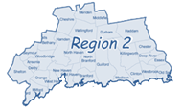
Created by the
Joint Regions 2 and Region 5 ESF #8
Family Assistance Center Subcommittee

Slide 3



PRESENTER
Jessica Stelmaszek, MPH
Director of Health
Naugatuck Valley Medical Reserve Corps Director
Naugatuck Valley Health District
98 Bank Street
Seymour, CT 06483
203-881-3255
jstelmaszek@nvhd.org
Naugatuck Valley
Notes:
CT Department of Mental Health and Addiction Services
CT Department of Children and Families
Center for Trauma Response, Recovery and Preparedness
CT’s Disaster Behavioral Health Response Network (CT-DBHRN)

Slide 4
OBJECTIVES
CT Regional Emergency Response
FAC Operations
FAC Job Functions
FAC Planning Considerations

Slide 5
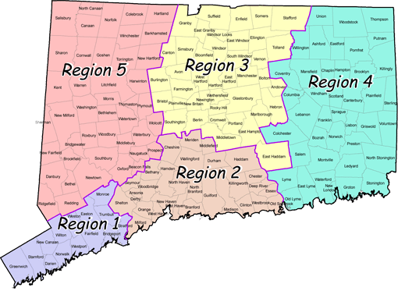
CT Department of Emergency Services and Public Protection
Division of Emergency Management & Homeland Security
Regional Emergency Planning Teams (REPT, R1-5)
ESF1 Transportation
ESF2 Communications
ESF3 Public Works and Engineering
ESF4 Firefighting
ESF5 Emergency Management
ESF6 Mass Care, Housing, and Human Services
ESF7 Resources Support
ESF8 Public Health and Medical Services*
ESF9 Urban Search and Rescue
ESF10 Oil and Hazardous Materials Response
ESF11 Agriculture and Natural Resources
ESF12 Energy
ESF13 Public Safety and Security
ESF14 Long-term Community Recovery and Mitigation
ESF15 External Affairs
Map Source: http://www.ct.gov/demhs/cwp/view.asp?a=1903&q=295316

Slide 6
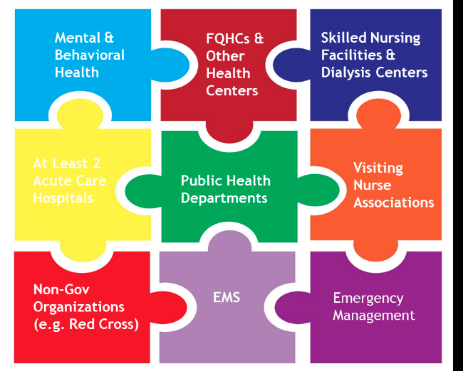
CT ESF #8 Healthcare Coalition Core Members
At Least 2 Acute Care Hospitals

Slide 7
MASS FATALITY MANAGEMENT
Ability to coordinate with other organizations to ensure the proper recovery, handling, identification, transportation, tracking, storage, and disposal of human remains and personal effects;
certify cause of death; and
facilitate access to mental/behavioral health services to the family members, responders, and survivors of an incident

Slide 8

FAC: DEFINED
Providing family assistance following MFI/MCI
Specific needs will vary widely
Google Images
Google Images
Notes:
FAC operations provide a framework for providing family assistance following a mass fatality or mass casualty incident.
Provision of services and information to the family members of those killed, injured, or otherwise impacted by the incident
Specific needs will vary widely
Presumes the provision of information & access to services is essential

Slide 9


https://www.youtube.com/watch?v=H0DbcjlVTKQ
Notes:
https://www.youtube.com/watch?v=H0DbcjlVTKQ

Slide 10
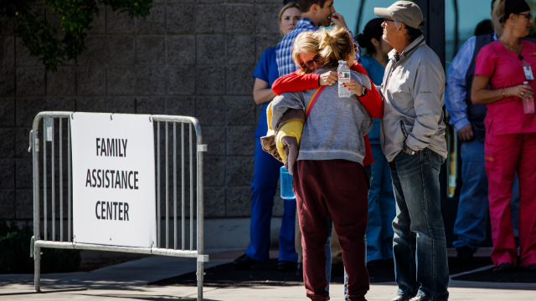
FAC: PURPOSE
Immediate aftermath of a MFI/MCI to give survivors and families of victims a safe, central gathering place in relative proximity to the disaster site
Physical, virtual or both
Google Images
Notes:
Focused on the immediate aftermath of a MFI/MCI to give survivors and families of victims a safe, central gathering place in relative proximity to the disaster site
While established at a physical location, the FAC may also be established virtually to support family members who may be unable or unwilling to travel to the geographic area near the incident

Slide 11
FAC: PURPOSE
Provides a venue for authorities to:
  Provide information to victims
  Coordinate access to support services
  Facilitate the collection of information
Notes:
Provides a venue for authorities to:
Provide information to victims,
Coordinate access to support services, and
Facilitate the collection of information from families that is necessary for victim identification

Slide 12
FAC: GOALS
To provide for a safe, private gathering location for families of victims, separated from the rest of the community
To coordinate and provide the support to meet the needs of these families
To provide for a location for the medical examiner and other public officials to meet with families, assist with investigative efforts, and for the release of official information

Slide 13
FAC HISTORY
Concept was born out of the experiences of families of aviation disasters and terrorism attacks
Needs:
  timely and official factual information
  privacy
  mechanism to receive support services while waiting for remains of victims to be identified and released
FAC model has been used multiple times, refined, and tailored over the years and across incidents
Notes:
Aviation Disaster Family Assistance Act (1996): the legislation gave specific responsibilities to the National Transportation Safety Board, the air carrier, and the American Red Cross to provide mental health, counseling, and other related services.
Rail Passenger Disaster Family Assistance Act (2006)

Slide 14
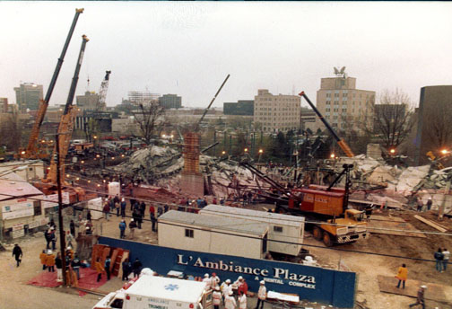
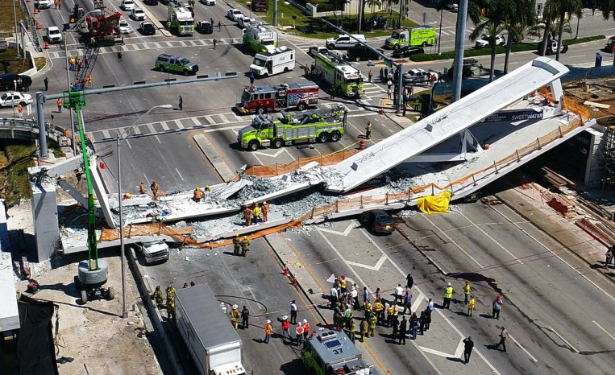
(1987) L’Ambiance Plaza building collapse
Google Images
(2018) FIU pedestrian bridge collapse
Google Images
Notes:
1987: L’Ambiance Plaza Building Collapse family gathering center at Kolbe Cathedral High School two blocks away
2018: Florida International University pedestrian bridge collapse. FAC & Reunification set up by FIU, Red Cross, and local authorities at Student Academic Success Center

Slide 15
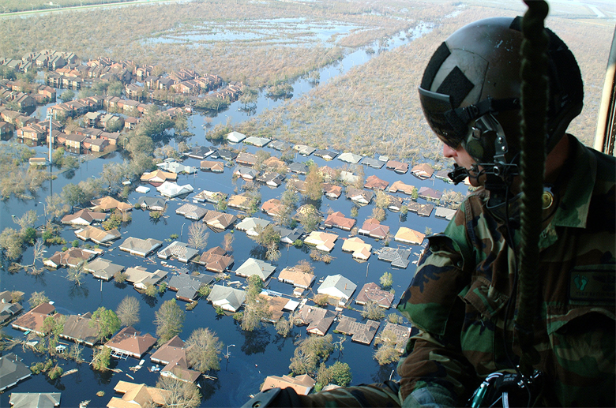
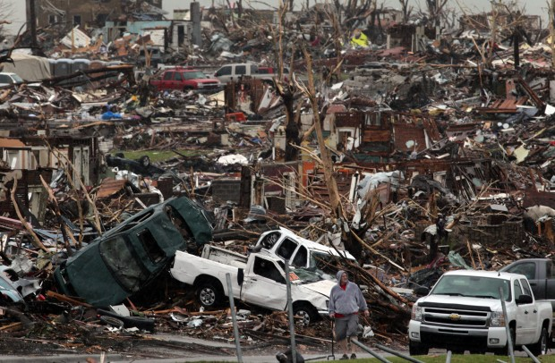
(2006) Hurricane Katrina
Google Images
(2011) Joplin Missouri EF5 Tornado
Google Images
Notes:
2006: FAC est. after Hurricane Katrina to manage missing person calls and coordinate information related to victim identification and return
2011: Joplin Missouri tornado EF5, multiple vortex tornado May 22, 2011.

Slide 16
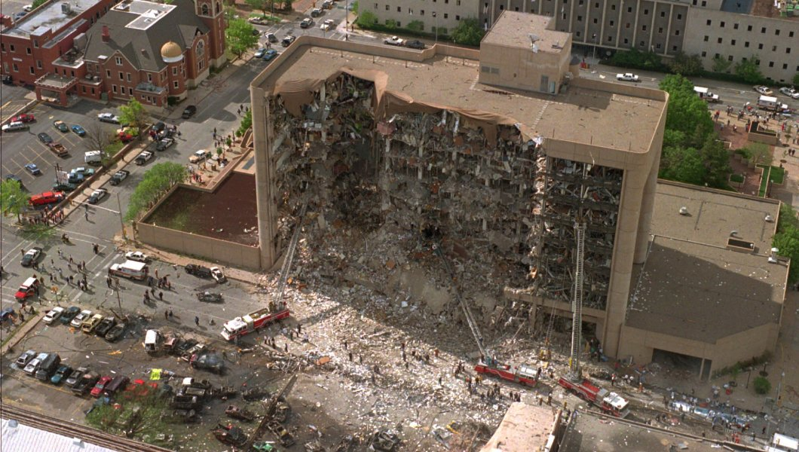
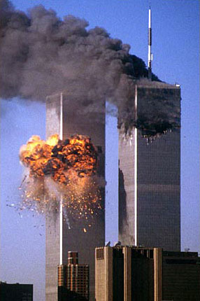
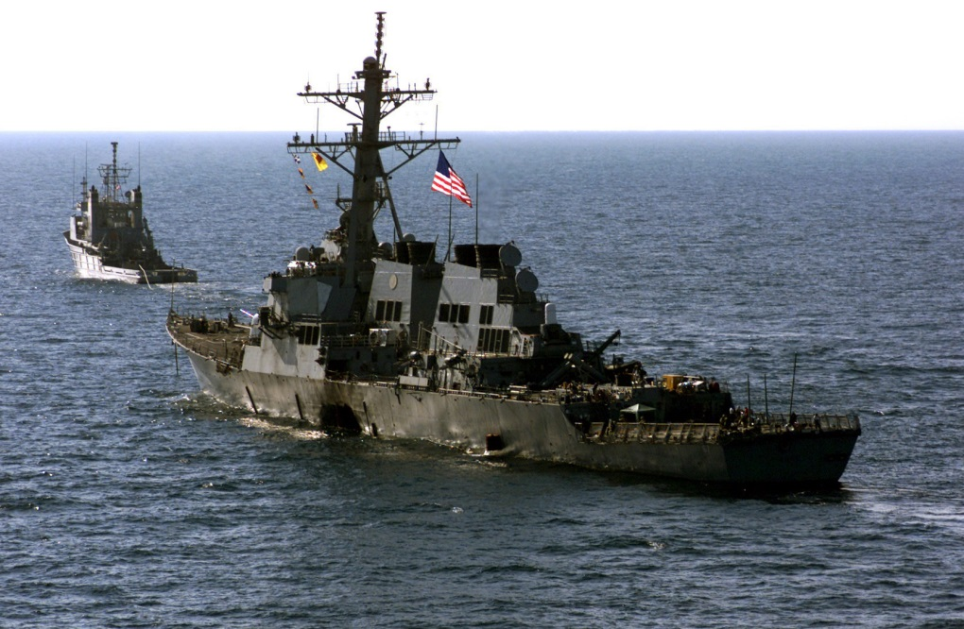
(1995) Murrah Federal Building bombing
(2000) USS Cole bombing
(2001) September 11th attacks
Notes:
1995: The “Compassion Center”- early version of an FAC established after the bombing of the Murrah Federal Building in Oklahoma City
2000: Department of Defense utilized NTSB FAC model for families of the USS Cole bombing
2001: Department of Defense utilized NTSB FAC model for families of September 11th attacks the on the Pentagon. FAC was also activated at Pier 94, NYC.

Slide 17
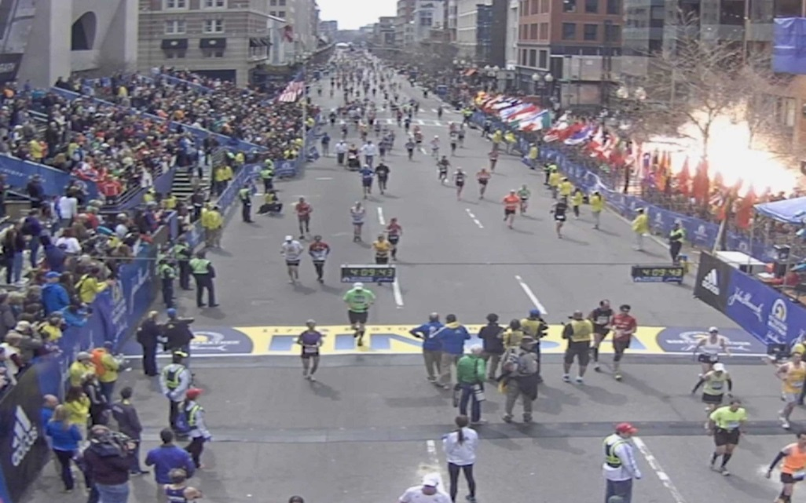

(2013) Boston Marathon bombings
Google Images
(2017) Las Vegas shooting
Google Images
Notes:
2013: Boston Marathon Bombings City of Boston opened a reunification center at the Castle at Park Plaza facility to assist affected individuals and runners provided services to an estimated 1,500 individuals.

Slide 18


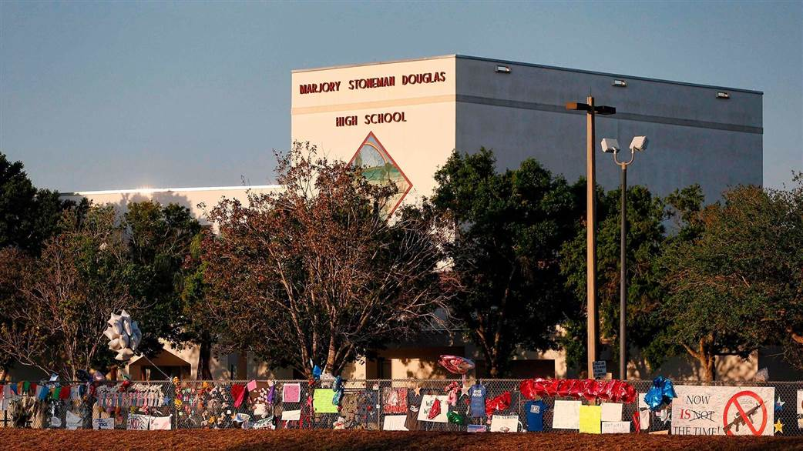
(2007) Virginia Tech
Google Images
(2012) Sandy Hook
Google Images
Google Images
(2018) Majory Stoneman Douglas
Notes:
2007: Virginia Tech Review Panel found FAC at The Inn at Virginia Tech fell short in helping families and others for 2 reasons: lack of leadership and lack of coordination among service providers
University volunteers stepped in but were not trained or able to answer many questions and guide families to the resources they needed
2012: Sandy Hook American Red Cross est. FAC in Newtown which provided mental health services, spiritual care services, health services and direct financial assistance for the for families and town Grieving Center set up at the Reed Intermediate School.
2018: Majory Stoneman Douglas

Slide 19
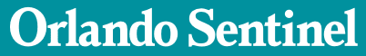

http://www.orlandosentinel.com/news/pulse-orlando-nightclub-shooting/87603919-132.html

Slide 20
ESTABLISHING A FAC
Scalable
  Needs-focused
Based on:
  Number of fatalities, serious injuries, and psychological impact
  Impact to the community
  Number of victims whose families do not reside in the disaster area
  Complexity of recovering and identifying fatal and injured victims

Slide 21
FAC: ACTIVATION
Included in FAC plan
Lead Agency
  NTSB? FBI? Local?
Example:
1
Local authorities identify need for FAC
2
Local EMD notifies Region DEMHS Coordinator requesting activation of a Region FAC Support Team
3
Region DEMHS Coordinator processes request
4
Assets will not be deployed until confirmed through the local contact at the EOC or ICP coordinating the activation

Slide 22
FAC: DURATION
Typical operation period: 1 – 3 weeks
Duration of which is tied to the:
    victim recovery
    identification process
    other investigative activities
Focused on short-term information and services
Notes:
Most FACs will operate for a period of 1 – 3 weeks, the duration of which is tied to the victim recovery and identification process and other investigative activities
Since the FAC is focused on short-term information and services, FAC management must develop plans to provide support and assistance to families once they depart the FAC

Slide 23
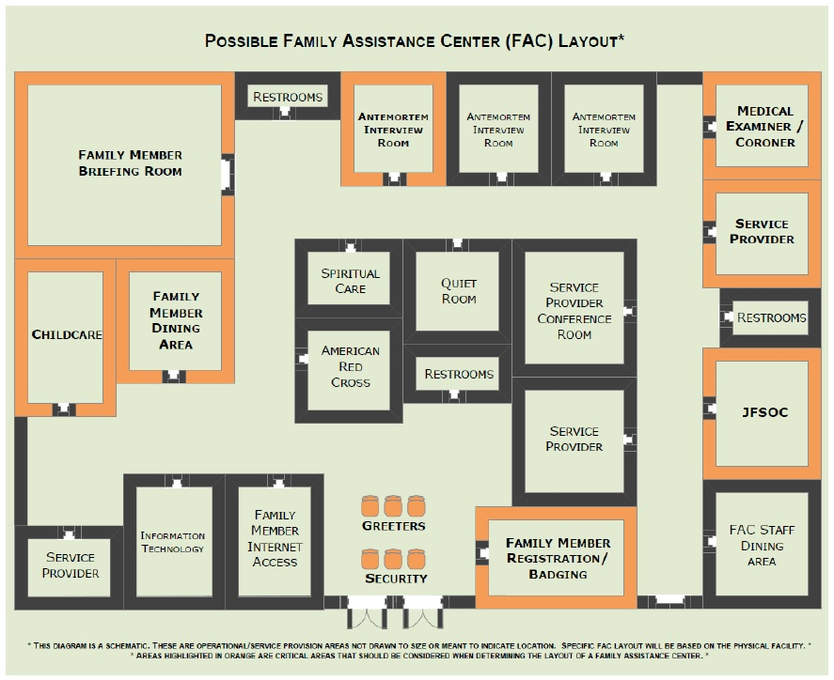
SAMPLE LAYOUT

Slide 24
FAC Plan Considerations*
*This section may not include all the necessary plan components and may vary depending on the type of organization creating the plan (Health Dept. vs University)

Slide 25
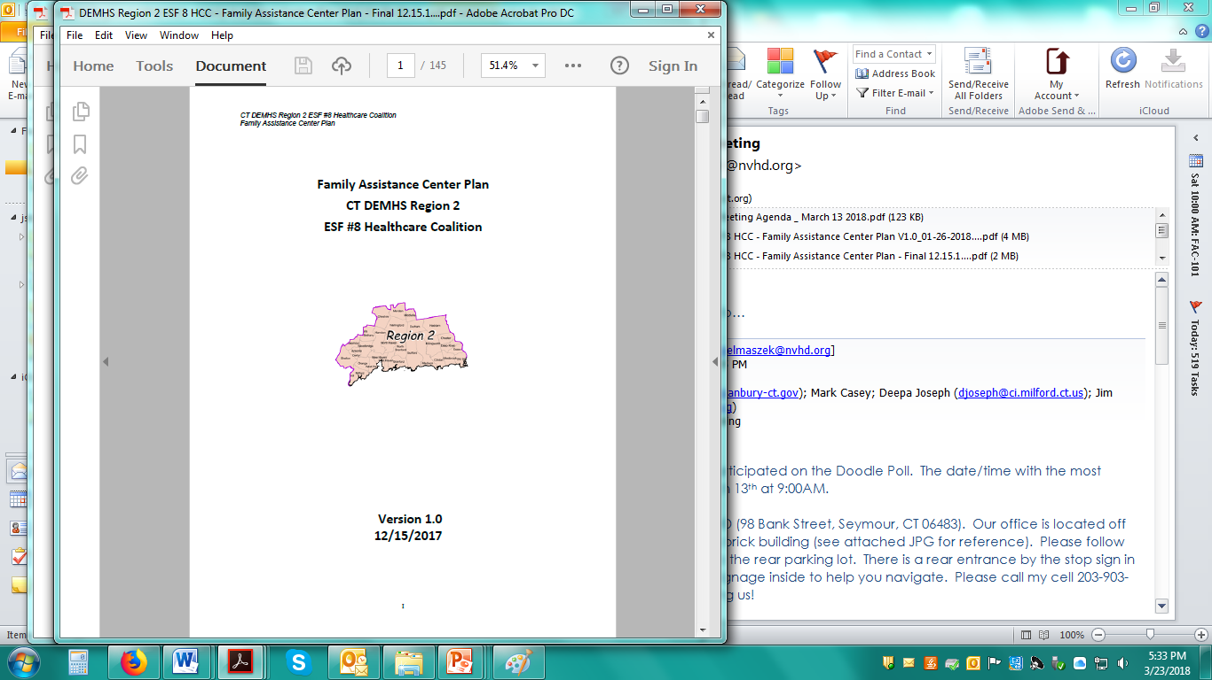
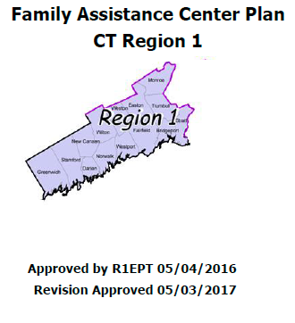
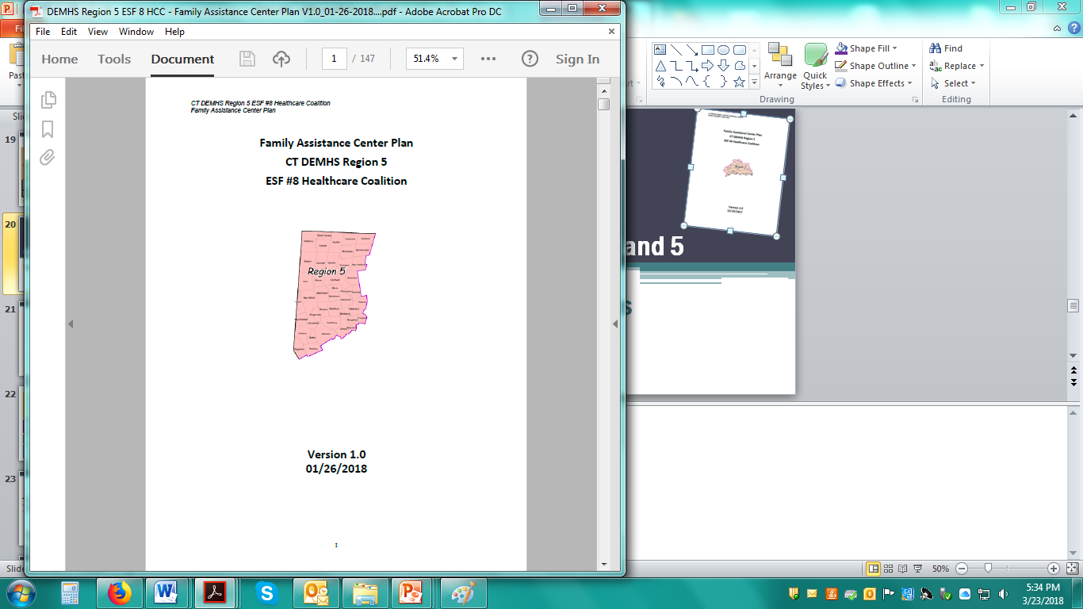
*Established Regional FAC Plans as of 6/1/2018
Notes:
As of June 1, 2018, three CT DEMHS planning regions have formally approved VERY SIMILAR FAC plans. Consistency helps with regional support/response. Region 3 has a plan and is working to create additional resources (i.e. resource packet that will be shared with 2,5,1). Region 4 (?).
Timeframe
Partners / contributors
Owner
Maintenance
Training
Drill/exercise

Slide 26
ASSUMPTIONS
  Incidents warranting the activation of an FAC may occur as a result of natural, human-caused, or technological sources and may vary in size, scope and complexity.
  The demands of FAC operations, in addition to managing the primary incident, can easily exceed local resources and may require a regional response.
  FAC operations may be long-term.
  Responding to a MCI or MFI can be overwhelming and lead to traumatic stress. Support for responders and staff at an assistance center will be essential.
  Ethnic, religious, and cultural traditions must be considered at all FACs.
  Both behavioral health and spiritual care resources need to be made available at FACs.
  It is anticipated that there may be 10+ family members or loved ones that may arrive or need assistance for each potential victim.
  Not all family members will come to the FAC. Services need to be available virtually to support and provide information to those who are not physically on site at the FAC.
  After an incident, family members will immediately call or self-report to agencies or locations seeking information about their loved ones. This could include the incident site, 911, 211, hospitals, clinics, fire departments, police stations, EMS stations, town/city hall, or the Medical Examiner’s Office
  Coordination among responding agencies about family member welfare inquiries, missing persons reports, and patient tracking will be necessary.

Slide 27
ASSUMPTIONS (cont.)
The FAC should be operational in a timely manner. Certain incidents will require a sense of urgency in establishing the FAC to provide basic services as soon as possible.
There may be a need to provide a place for families to convene until an FAC is established. This may occur at a hospital, airport, or other community site.
The FAC may need to operate extended hours during the initial days or weeks after an incident.
The FAC will NOT serve as an overnight shelter.
Large media presence will necessitate on-site public information officer (PIO) assistance.
This regional plan is designed to facilitate collaboration and coordination in a regional response without any presumption of a regional funding source; financial costs to responding jurisdictions will be borne in a manner similar to any response or recovery effort. The funding source for the FAC operations may not be known at the time the FAC is opened.
Donations will not be accepted or processed at the FAC.
Photography should not be allowed in any part of the FAC.

Slide 28
ASSUMPTIONS (cont.)
Family Concerns
Family members will have high expectations regarding the:
  identification of the deceased;
  return of their loved ones to them; and
  ongoing information and updates
    victim ID may take days, weeks or more depending on the nature of the incident
Families and individuals will not grieve or process information in the same way.
Ethnic and cultural traditions will be important factors in how families grieve.
Family members who live afar may travel to the FAC and need assistance with basic resources such as lodging, toiletries, clothes, prescriptions, etc.
Family interviews will need to be conducted with multiple family members in order to collect sufficient ante mortem information to assist with victim identification.
Media will want to access the FAC and some family members will want to speak with them and some will not.

Slide 29
SCOPE
Establishment and operation of a FAC where:
    It is anticipated that the operation of the FAC will exceed local resources
    Standard mutual aid requests to neighboring municipalities alone will be insufficient
    A specific request for the deployment of regional resources to stand up an FAC has been made by the municipality where the incident is located
Certain incidents will result in the activation of a Joint Family Support Operations Center and/or FAC by federal agencies. Those operations are beyond the scope of this plan.

Slide 30
SITE REQUIREMENTS
Best location will largely be contingent upon the type of incident and the number of fatalities
Local officials may conduct assessments to pre-determine potential sites
  Local EMDs & LHD
  Appendix B: Facility Agreement
Consider public (e.g., municipal facilities) and private (e.g., hotels with conference centers) venues
If a FAC is being considered outside the jurisdiction of the primary incident scene, the requesting EMD must contact the EMD of the desired jurisdiction for the FAC to approve and coordinate such operations
Appendix D: Activation Checklist and Appendix E: Facility Opening & Closing Form
Notes:
Ideally, the FAC should be established in a facility such as a modern hotel or convention center with conference rooms, reception areas, private interviewing rooms, telecommunications, computer support, Internet access, telephone lines, (nearby) lodging accommodations, food service, accessibility (i.e. Americans with Disabilities Act (ADA) accommodations), and parking. A FAC must be of sufficient size and appropriate design to permit core direct services to be provided in a secured environment that offers seclusion from the media, as well as the provision of other disaster services.

Slide 31
SITE SECURITY ASSESSMENT
Should be made prior to starting operations
Law Enforcement is responsible for assessment, unless they have delegated the task to another qualified entity
Plan include general outline of basic security assessment
Appendix F: Site Assessment Worksheet

Slide 32
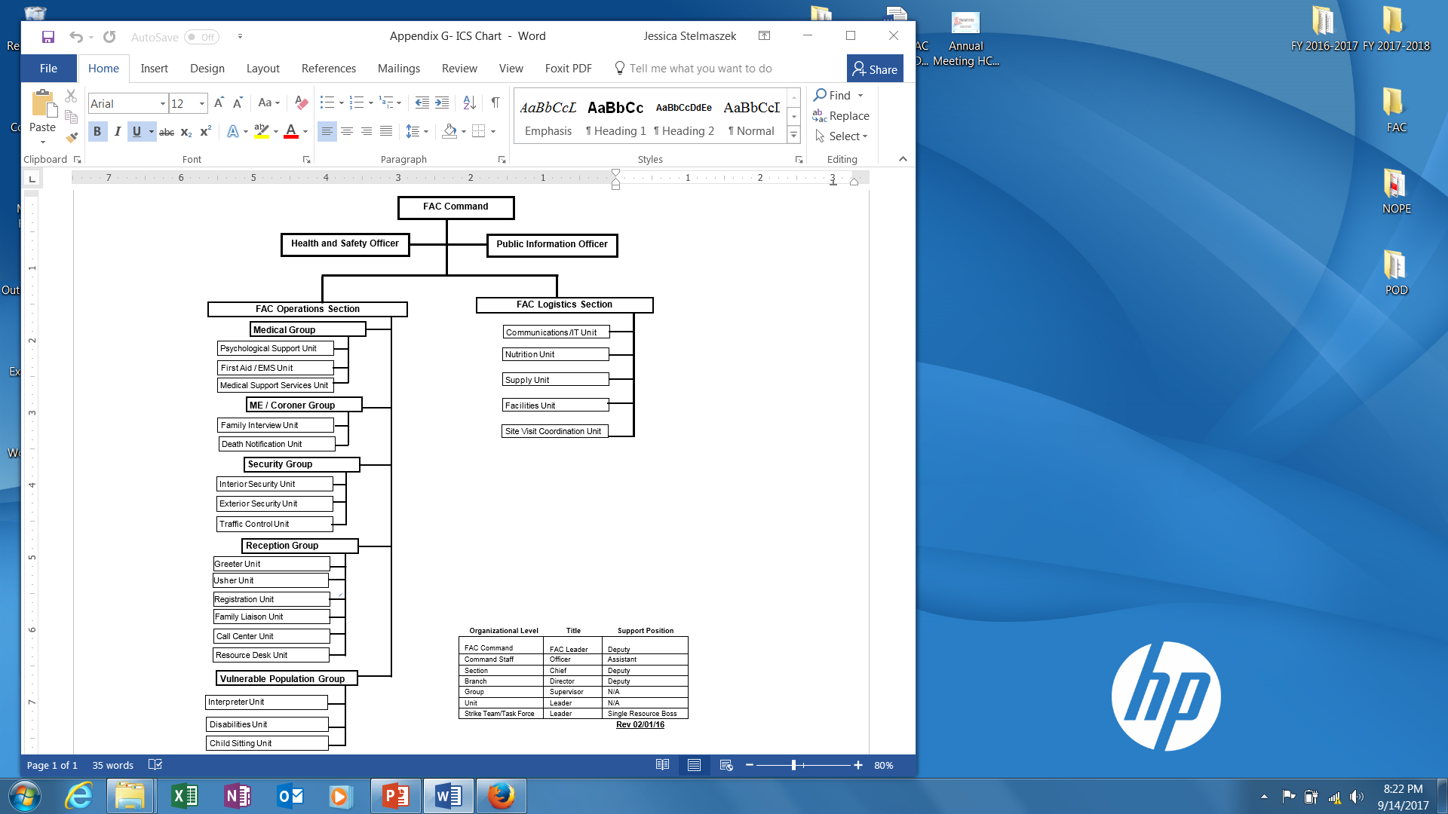
STAFFING
Overall leadership of the FAC will be assigned by Incident Command and integrated into the ICS Organization
Appendix G: Sample FAC Organizational Chart
Appendix H: Staff Determination Tool
Notes:
The Labor Pool may be sourced from:
Police, Fire, EMS
Municipal staff (e.g., Local Health Department/District, Public Works, Social Services, Community Services, etc.)
Medical Reserve Corps (MRC)
Community Emergency Response Team (CERT)
American Red Cross (ARC)
Other local and/or regional agencies with appropriately trained staff and/or volunteers (e.g., universities, community health providers, community mental health providers, family service agencies, etc.) at the discretion of Incident Command.
Other state assets (e.g., Office of the Chief Medical Examiner, Emergency Credentialing Program, Disaster Behavioral Health Response Network) as available, necessary and appropriate based upon jurisdiction and/or at the discretion of Incident Command.
Other federal assets (e.g., FBI, U.S. Department of Justice) as available, necessary, and appropriate based upon jurisdiction and/or at the discretion of Incident Command.

Slide 33
STAFFING
Registration & Credentialing
Identification
Shift Change Procedure
Staff Briefings
Policy on Spontaneous Unaffiliated Volunteers

Slide 34
FAC MANAGEMENT
FUNCTIONS:
Providing overall leadership and authority at the FAC
Identifying needs & gaps
Ensuring communication and coordination across agencies represented at the FAC
Anticipate and coordinate any dignitary visits to the FAC
Coordinating release of information in concert with overall incident PIO or JIC
Coordinating and managing requests and authorizing resources
Avoiding duplication of services
Setting priorities as relates to the FAC
Plan for transition
RESPONSIBLE AGENCIES: The FAC Command staff will be determined and designated by the IC/EOC

Slide 35
MEDIA & PIO
Media access – yes or no
  PIO will handle media inquiries and public information dissemination
  Appendix L: PIO Cheat Sheet
FUNCTIONS:
Directly coordinate with the overall incident PIO
Coordinate release of approved information
Serve as single point of contact for any media inquiries
Refer media to appropriate locations
Monitor social media as necessary
Provide for rumor control
Disseminate correct information as appropriate
RESPONSIBLE AGENCIES: This position will be assigned based upon the specific circumstances of the incident and the agency best suited to support this role

Slide 36
SAFETY OFFICER
FUNCTIONS:
Will maintain vigilance over facility safety, including:
Ensuring environmental safety of the building is maintained
Ensuring fire safety (e.g., exists not blocked, no overcrowding, etc.)
Identifying and referring any security concerns
RESPONSIBLE AGENCIES: FAC Safety Officer will typically be assigned from the IC Safety Officer
Appendix M: Safety Walkthrough Checklist

Slide 37
RESOURCE DESK
FUNCTIONS:
Resource Desk at the FAC is staffed to help families navigate the services offered at the FAC
Will have various documents and forms available to assist families, as well as ability to refer family members to appropriate on-site support when appropriate.
A listing of available resources should be made available
Sample lists of commonly requested resources are provided in the appendices of the plan
RESPONSIBLE AGENCIES:
Resource Desk can be staffed by any response organization personnel as assigned
Whenever possible, behavioral health should be available in this area to provide support.

Slide 38
GREETERS
FUNCTION:
Positioned near the Resource Desk
Tasked with screening incoming individuals, welcoming incoming family members and directing them to the registration area
Should know how to access approved translation services
Individuals who are clearly not looking for family members are referred elsewhere as appropriate
Individuals arriving at the FAC who are not looking for a family member and do not leave immediately are reported to security
RESPONSIBLE AGENCIES:
Greeters can be staffed by any response organization personnel as assigned
If resources are not available, this function can be performed by Security
Behavioral Health should be available in this area to provide support

Slide 39
USHERS
FUNCTION:
Positioned near the Resource Desk
Tasked with escorting family members within the FAC as necessary, such as assisting in navigating within the FAC or when bringing family members to a secure location within the FAC
RESPONSIBLE AGENCIES:
Ushers can be staffed by any response organization personnel as assigned.

Slide 40
FAMILY REGISTRATION
FUNCTION:
Upon arrival, family members are directed to the Family Registration area where the following procedure is utilized to register family members at the FAC
Reception and registration will set the tone for the FAC and will provide families with an orientation to family assistance operations and the services available
Throughout the registration process translation, interpretation, American Sign Language and braille services should be on hand to assist with any needs
Behavioral health providers should also be on hand during client welcoming and registration to provide services as needed
RESPONSIBLE AGENCIES:
Any response organization personnel as assigned
Behavioral Health and Translation services should be available to provide assistance with the registration process if necessary

Slide 41
FAMILY REGISTRATION PROCEDURE
All family members will sign-in upon arrival
If this is the family member’s first visit to the FAC they must complete a registration form
  Appendix N: Family Registration Form
If someone has presented to the registration area and is not looking for a family member or is providing suspicious information, notify security immediately
Site security is crucial to preserving privacy
“Family” will include immediate family and household members
  At the discretion of the FAC leadership, may be expanded to other individuals that consider the victim to be a part of the victim’s family, even if there is not a legal familial relationship, and/or individuals that investigators wish to bring to the FAC

Slide 42
FAMILY REGISTRATION PROCEDURE (cont.)
Adult family members will be asked to sign-in and provide government-issued photo ID during the registration process to confirm their identity. Individuals who cannot produce ID will be referred to Law Enforcement
  Appendix O: Family Sign In-Out Form
All registered family members will have a wristband placed (color by day)
Provide all family members with a Family Resource Packet if available
For the purposes of continuity of care and if staff resources allow, a Family Liaison should be assigned whenever possible based upon resource availability
All family members must remove their wristband at the close of the FAC for the duration of the operation

Slide 43
FAMILY LIAISON
FUNCTION:
An individual assigned to a family to provide family members with a brief overview of the services provided at the FAC,
provide them with the time of the next scheduled Family Briefing,
a tour of the facility (if possible) and assist them with the items in the Family Resource Packet and with any immediate and ongoing needs during the course of their stay at the FAC
RESPONSIBLE AGENCIES:
While the Family Liaison may be assigned to any response organization as assigned by Incident Command, behavioral health support should be strongly considered

Slide 44
VULNERABLE POPULATIONS
Children and adults with disabilities have the same right to services in general population as other residents
Disabilities may vary and include: physical, sensory, mental health, and cognitive and/or intellectual disabilities
Effective communication
Program Modifications

Slide 45
TRANSLATION/INTERPRETER SERVICES
Linguistic competence: the capacity to communicate effectively, and convey information in a manner that is easily understood by diverse audiences including persons of limited English proficiency, those who have low literacy skills or are not literate, and individuals with disabilities
Translation and interpreter services may be necessary at the FAC and should be anticipated
Easily understood individual-related materials, vital information in most commonly encountered languages and appropriate signage during the FAC will be made available to the extent possible
Appendix P: Translation/ Interpretation Resources

Slide 46
CULTURAL CONSIDERATIONS
Values, norms, and traditions of different populations affect how individuals perceive, think about, and make judgments about health, health behaviors, and public health services
Cultural traditions will impact a wide range of issues, including the family grieving process and spiritual care needs and will be important to survivors
There will likely be specific concerns regarding:
  Autopsies
  Timeframe and handling of the body, including ceremonial washing of the deceased
  Religious ceremonies and/or items to be left with the dead
  Medical Examiner/Coroner will need to determine to what extent he/she is able to accommodate various religious beliefs and practices
Appendix Q: Cultural and Religious Considerations

Slide 47
ANIMALS
Only service animals in compliance with state and federal law will be permitted at the FAC
Resources permitting, an animal shelter for pets may be established within or near the same facility as the FAC, with the intention that family members will be available to assist in their care
  If necessary, activate the local Animal Control Officer and/or the regional State Animal Response Team

Slide 48
FAMILY BRIEFINGS
FUNCTION:
Conducted as a group to provide and disseminate general information on the status of the overall response and recovery effort, educate family members on the process of victim identification, what to expect at the FAC, and what services are available through the FAC
Primary goal is to ensure that families have current and accurate information
RESPONSIBLE AGENCIES:
Briefings will be coordinated by FAC leadership with information provided by representatives from Law Enforcement, Medical Examiner, and others as deemed appropriate by Incident Command, such as representatives from state and federal agencies

Slide 49
FAMILY BRIEFINGS (cont.)
Guidelines
  Always provide information to the families before releasing information to the media
  The Medical Examiner, or their designee, should be present at all briefings to report on victim identification processes and progress
Procedure
  PIO in coordination with the FAC Director and Medical Examiner schedules the time and location of the family briefings
Agenda/Talking Point Guidelines

Slide 50

FAMILY INTERVIEWS
FUNCTION:
Collection of ante mortem data for identification of human remains and to assist in the investigation
Conducted in private interview room(s) or designated areas
Appendix R: DMORT VIP Ante Mortem Interview Form
RESPONSIBLE AGENCIES:
Primary: Law Enforcement; Medical Examiner; assigned DMORT members if activated
Support: Behavioral Health, Faith-based Organizations

Slide 51
DEATH NOTIFICATIONS
FUNCTION:
Formal notification of death to next of kin
RESPONSIBLE AGENCIES:
Primary: Law Enforcement; Medical Examiner
Support: Behavioral Health, Faith-based Organizations

Slide 52
RELEASE OF PERSONAL EFFECTS
FUNCTION:
Formal release of personal effects from victims to family
RESPONSIBLE AGENCIES:
Primary: Law Enforcement; Medical Examiner
Support: Behavioral Health, Faith-based Organizations
Re-association of Remains
In situations where remains are fragmented and commingled, identified remains may be re-associated so that remains belonging to individuals are returned together to the next of kin. Often, because DNA analysis is the method used to conduct these identifications, the physical re-association of remains can take place several weeks or months after an accident.

Slide 53
MFI/MCI IMPACT
Overwhelming
  Numbers
  Sensations
  Images
  Sounds
  Public Exposure
Challenging
  For all responders/workers

Slide 54
PSYCHOLOGICAL SUPPORT SERVICES
FUNCTIONS:
Psychological services include a wide range of support
Providing access to these services is a key component of the FAC
RESPONSIBLE AGENCIES:
Refer to Table on next slide

Slide 55
FAC Functional Area | Behavioral Health Support Description | Credentials Required | Potential Source Agencies (always subject to IC approval)
Staff Briefing | Prepare staff for shift. Ideally a brief PFA JITT included. | FAC Behavioral Health Lead or designee | LHD, MRC, DBHRN, ARC
Staff Debriefing at end of shift and at FAC closure | Check-in/support at end of shift/at FAC closure | FAC Behavioral Health Lead or designee | LHD, MRC, DBHRN, ARC, EAP
Reunification Services (if included at FAC) | Behavioral health support/ Psychological First Aid | Minimally PFA Training. Ideally a credentialed behavioral health responder. | LHD, MRC, CERT, DBHRN, ARC
Resource Desk Services | Behavioral health support/ Psychological First Aid | Minimally PFA Training. Ideally a credentialed behavioral health responder. | LHD, MRC, CERT, DBHRN, ARC
Family Registration Activities | Behavioral health support/ Psychological First Aid | Minimally PFA Training. Ideally a credentialed behavioral health responder. | LHD, MRC, CERT, DBHRN, ARC
Family Briefings | Behavioral health support/ Psychological First Aid | Minimally PFA Training. Ideally a credentialed behavioral health responder or clergy. | LHD, MRC, CERT, DBHRN, ARC, Clergy
Family Interviews | Behavioral health support/ Psychological First Aid | Minimally PFA Training. Ideally a credentialed behavioral health responder or clergy. | LHD, MRC, CERT, DBHRN, ARC, Clergy
Death Notifications | Behavioral health support/ Psychological First Aid | Minimally PFA Training. Ideally a credentialed behavioral health responder or clergy. | LHD, MRC, CERT, DBHRN, ARC, Clergy
Release of Personal Effects | Behavioral health support/ Psychological First Aid | Minimally PFA Training. Ideally a credentialed behavioral health responder or clergy. | LHD, MRC, CERT, DBHRN, ARC, Clergy
Referral to community-based mental health providers | Follow-up information for ongoing behavioral health care | Minimally PFA Training. Ideally a credentialed behavioral health responder or clergy. | LHD, MRC, CERT, DBHRN, ARC, Clergy, Local Social Services

Slide 56
PSYCHOLOGICAL FIRST AID
8 Core Actions
  Contact and Engagement
  Safety and Comfort
  Stabilization
  Information Gathering
  Practical Assistance
  Connections with Social Support
  Information on Coping
  Linkage with Collaborative Services

Slide 57
FAC RESPONDER SELF-CARE
The decision to deploy
  Personal comfort level with the response and your role in it
  Current physical health
  Recent significant life events
  Current family/personal network circumstances
Plan for self-care during the response
Plan for self-care following the response

Slide 58
PSYCHOLOGICAL SUPPORT SERVICES
Individuals identified to be in immediate crisis (e.g., suicidal ideation) will be continuously monitored and immediately referred to EMS for hospital transport & evaluation
Individuals unwilling to be transported who are determined by a proper authority (e.g., police officer; psychologist; or clinical social worker or advanced practice registered nurse with additional training required by state statute) to be a danger to themselves or others will be transported to a hospital by EMS under a properly signed Emergency Evaluation Request

Slide 59
MEDICAL SUPPORT SERVICES
Emergency Medical Services
  EMS available at the FAC may be limited to First Aid, based upon availability of personnel
  FAC leadership will determine if onsite standby by a higher level of care (e.g., EMT) and/or need for an onsite standby ambulance is needed
Medical Care & Pharmacy
  Limited to connecting clients to health care providers and pharmacies
  Primarily directed to out of state family members that may be unaware of the services available and need assistance

Slide 60
SITE VISITS
Family members may express a desire to visit the incident scene
  Coordinated by IC and only scheduled once the site is safe and human remains and clearly distinguishable personal effects are either removed or not visible from a viewing area
FUNCTIONS:
Assist Law Enforcement and IC as needed with scheduling and transportation of family members from the FAC to the Incident Scene
Assist with credentialing of family prior to departure from FAC
RESPONSIBLE AGENCIES:
Any response organization personnel as assigned. If available and subject to IC approval, behavioral health, a member of the clergy and/or the Family Liaison may accompany family members to visit the scene

Slide 61
MEMORIAL EVENTS
Memorial events have been identified as an important part of transition for families leaving the FAC prior to returning home
Wide range of possible events, including multi-faith spiritual services, onsite memorials, vigils, etc.
Typically public events
FUNCTION:
The FAC will assist and coordinate in regards to providing family members with the schedules of events and assisting with transportation needs
RESPONSIBLE AGENCIES:
Any response organization personnel as assigned

Slide 62
OTHER FAMILY SUPPORT SERVICES
Travel & Other Assistance
Child Sitting
  Provided at the discretion of the IC, allowing parents and guardians to conduct interviews with officials and attend certain meetings, etc. where they do not feel their children should be present
  Outside of these parameters, it is expected that parents/guardians will provide for the care of their children at all times
  Appendix S: Child Sitting Area Sign In
  Appendix T: Child Sitting Safe Area Checklist

Slide 63
CALL CENTER / HOTLINE
At the discretion of IC
As soon as family members become aware of an incident, they will seek official information and/or request assistance
FAC Call Center may perform several of the functions of the FAC virtually as needed, and may be co-located at a physical FAC to ensure efficient coordination of resources and information
Appendix U: Call Center Log Form
Appendix V: Call Center Intake Form
Appendix W: Call Center Script
Notes:
211

Slide 64
LOGISTICS
Facility Maintenance
Tactical Communications
Information Technology
Nutrition Services
Demobilization
  Fewer than 5 clients per day register at the FAC 3 days in a row
  Memorial services have been arranged for family and friends
  Provision for the return of personal effects has been arranged
  Ongoing case management and/or hotline number has been established if needed
  Appendix X: Demobilization Procedures
  Appendix Y: Demobilization Checklist

Slide 65
SAMPLE APPENDICES
A | Glossary of Acronyms
B | Facility Agreement
C | Sample Floor Plan
D | Activation Check List
E | Facility Opening & Closing Form
F | Site Assessment Worksheet
G | Sample FAC Organizational Chart
H | Staff Determination Tool
I | Job Action Sheets
J | ICS-211
K | Briefing Checklist
L | PIO Cheat Sheet
M | Safety Walkthrough Checklist
N | Family Registration Form
O | Family Sign In-Out Form
P | Translation/Interpreter Services
Q | Cultural and Religious Considerations
R | DMORT VIP Ante Mortem Interview Form
S | Child Sitting Area Sign In
T | Child Sitting Safe Area Checklist
U | Call Center Log Form
V | Call Center Intake Form
W | Call Center Script
X | Demobilization Procedures
Y | Demobilization Checklist
Z | References

Slide 66
BEFORE
AFTER
Reunification Center
Resiliency Center
  a place of healing and support dedicated to serving as a resource and referral center for residents, visitors and responders affected
  not open to the general public
  victim advocacy and support; case management; counseling and spiritual care referrals, technical assistance with applying for online services including FBI Victim Assistance services and more
  Long-term; years long operation
  between survivors and family members
  primarily done immediately after an incident and typically prior to the establishment of a FAC
  at discretion of Incident Command, this function may be moved into the FAC when necessary and appropriate

Slide 67

QUESTIONS

Slide 68
REFERENCES
Mass Fatality Incident Family Assistance Operations: Recommended Strategies for Local and State Agencies, FBI Office for Victim Assistance and the NTSB Transportation Disaster Assistance Division
Target Capabilities List: A companion to the National Preparedness Guidelines, U.S. Department of Homeland Security, September 2007
Public Health Preparedness Capabilities: National Standards for State and Local Planning, Centers for Disease Control and Prevention, March 2011
Template Field Operations Guide for Reunification and Family Assistance, Twin Cities Metro Area Operations Curtain Call After Action Work Group, v.04212014
Mass Fatality and Family Assistance Operations Response Plan Version 4. Public Health-Seattle & King County Mass Fatality and Family Assistance Operations Response Plan. 2015
U.S. Department of Justice Federal Bureau of Investigation Office for Victim Assistance (FBI). Mass Fatality Incident Assistance Operations: Recommended Strategies for Local and State Agencies. Retrieved from https://ntsb.gov/tda/TDADocuments/Mass%20Fatality%20Incident%20Family%20Assistance%20Operations.pdf
www.fairfieldct.org/FAC
https://www.ovc.gov/pubs/mvt-toolkit/victim-assistance.html#fac
https://training.fema.gov/hiedu/docs/bray%20-%20growing%20trend%20for%20family%20assistance%20in%20hi%20ed%20em.docx
http://www.redcross.org/news/article/Family-Assistance-Center-in-Boston-Helps-Families-of-Victims-Heal
http://webcache.googleusercontent.com/search?q=cache:1vHgisFZSEQJ:www.ct.gov/ag/lib/ag/charities/sandyhook/txt/americanredcrosstext.pdf+&cd=1&hl=en&ct=clnk&gl=us
Images used from Google Images

